Slide 1

cryptocurrency (Bitcoin) price prediction Project using machine learning
Presented By-
KSHITIJ KUMAR
Course- Artificial Intelligence & Machine Learning

Slide 2
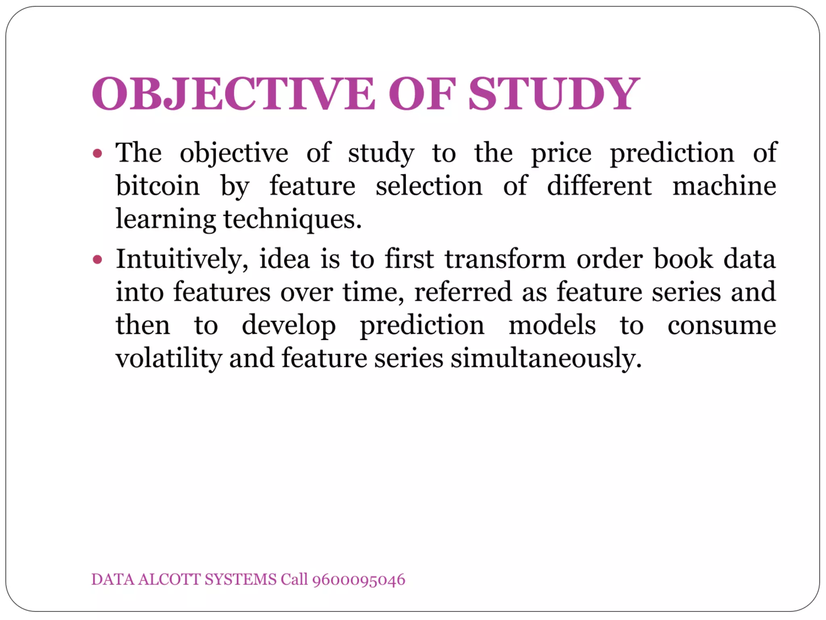
CONTENTS
Abstract
Problem Statement
Aim
Existing Systems
Requirements
Flowcharts
Datasets details
Modules
Graphs
Conclusions

Slide 3
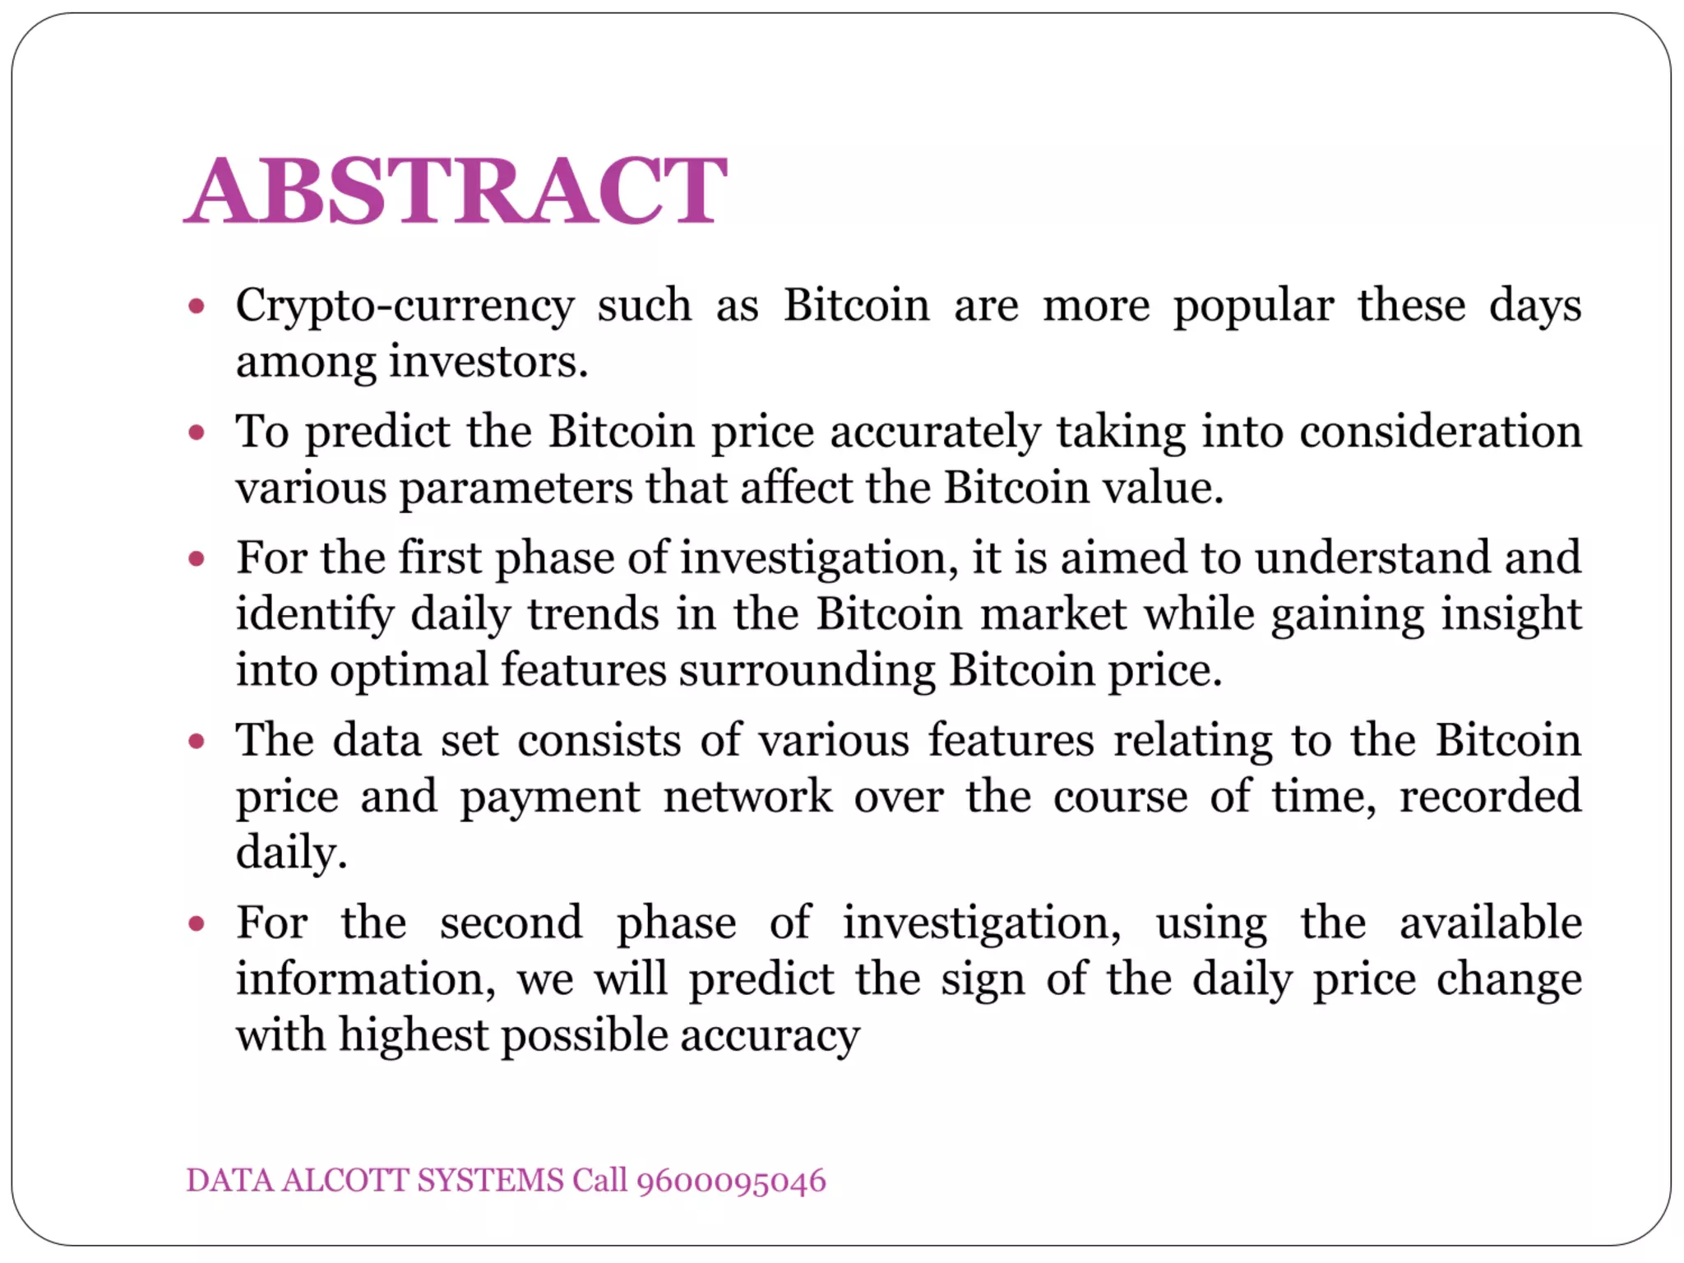

Slide 4
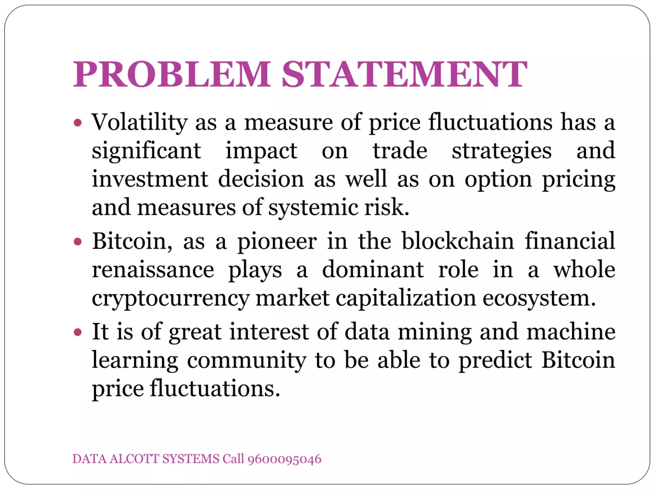
Bitcoin uses Blockchain concept which is peer to peer technology to operate with no central authority or banks, managing transactions and the issuing of bitcoins is carried out collectively by the network. Bitcoin is open-source, its design is public, nobody owns or controls Bitcoin and everyone can take part.

Slide 5
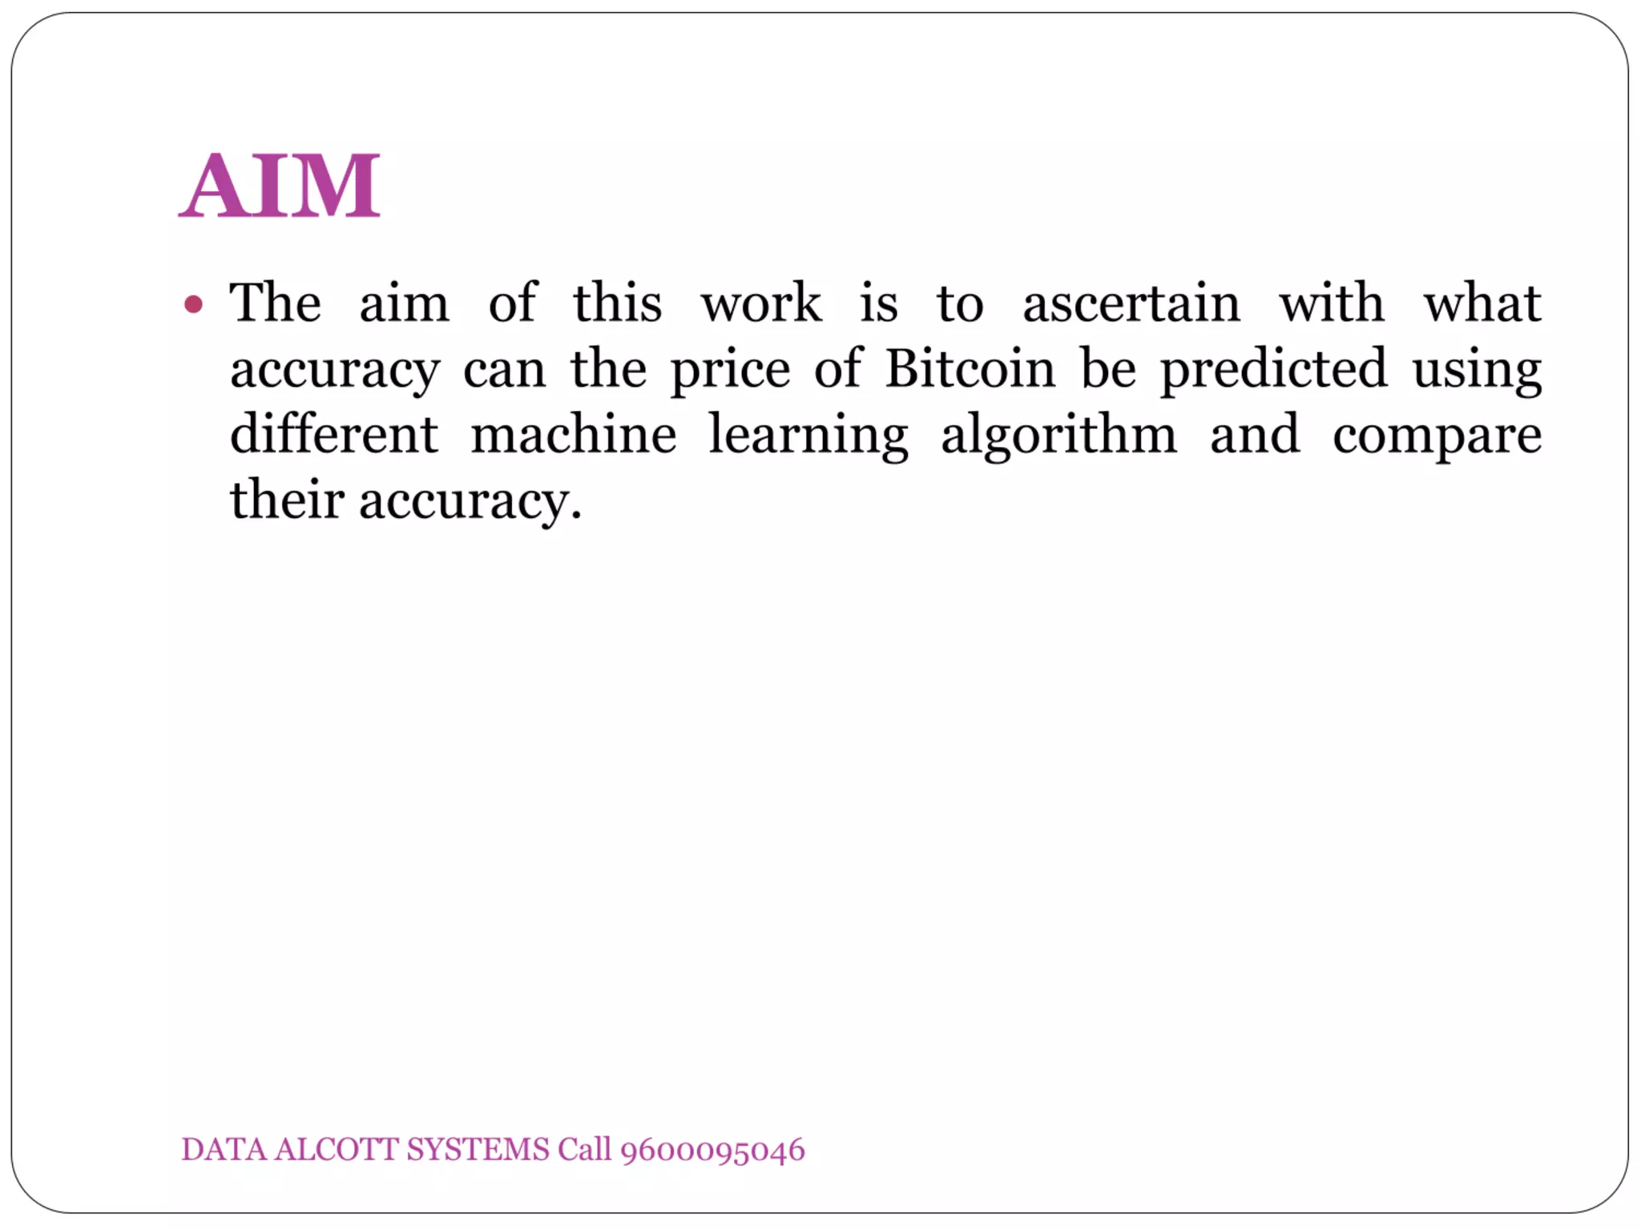

Slide 6
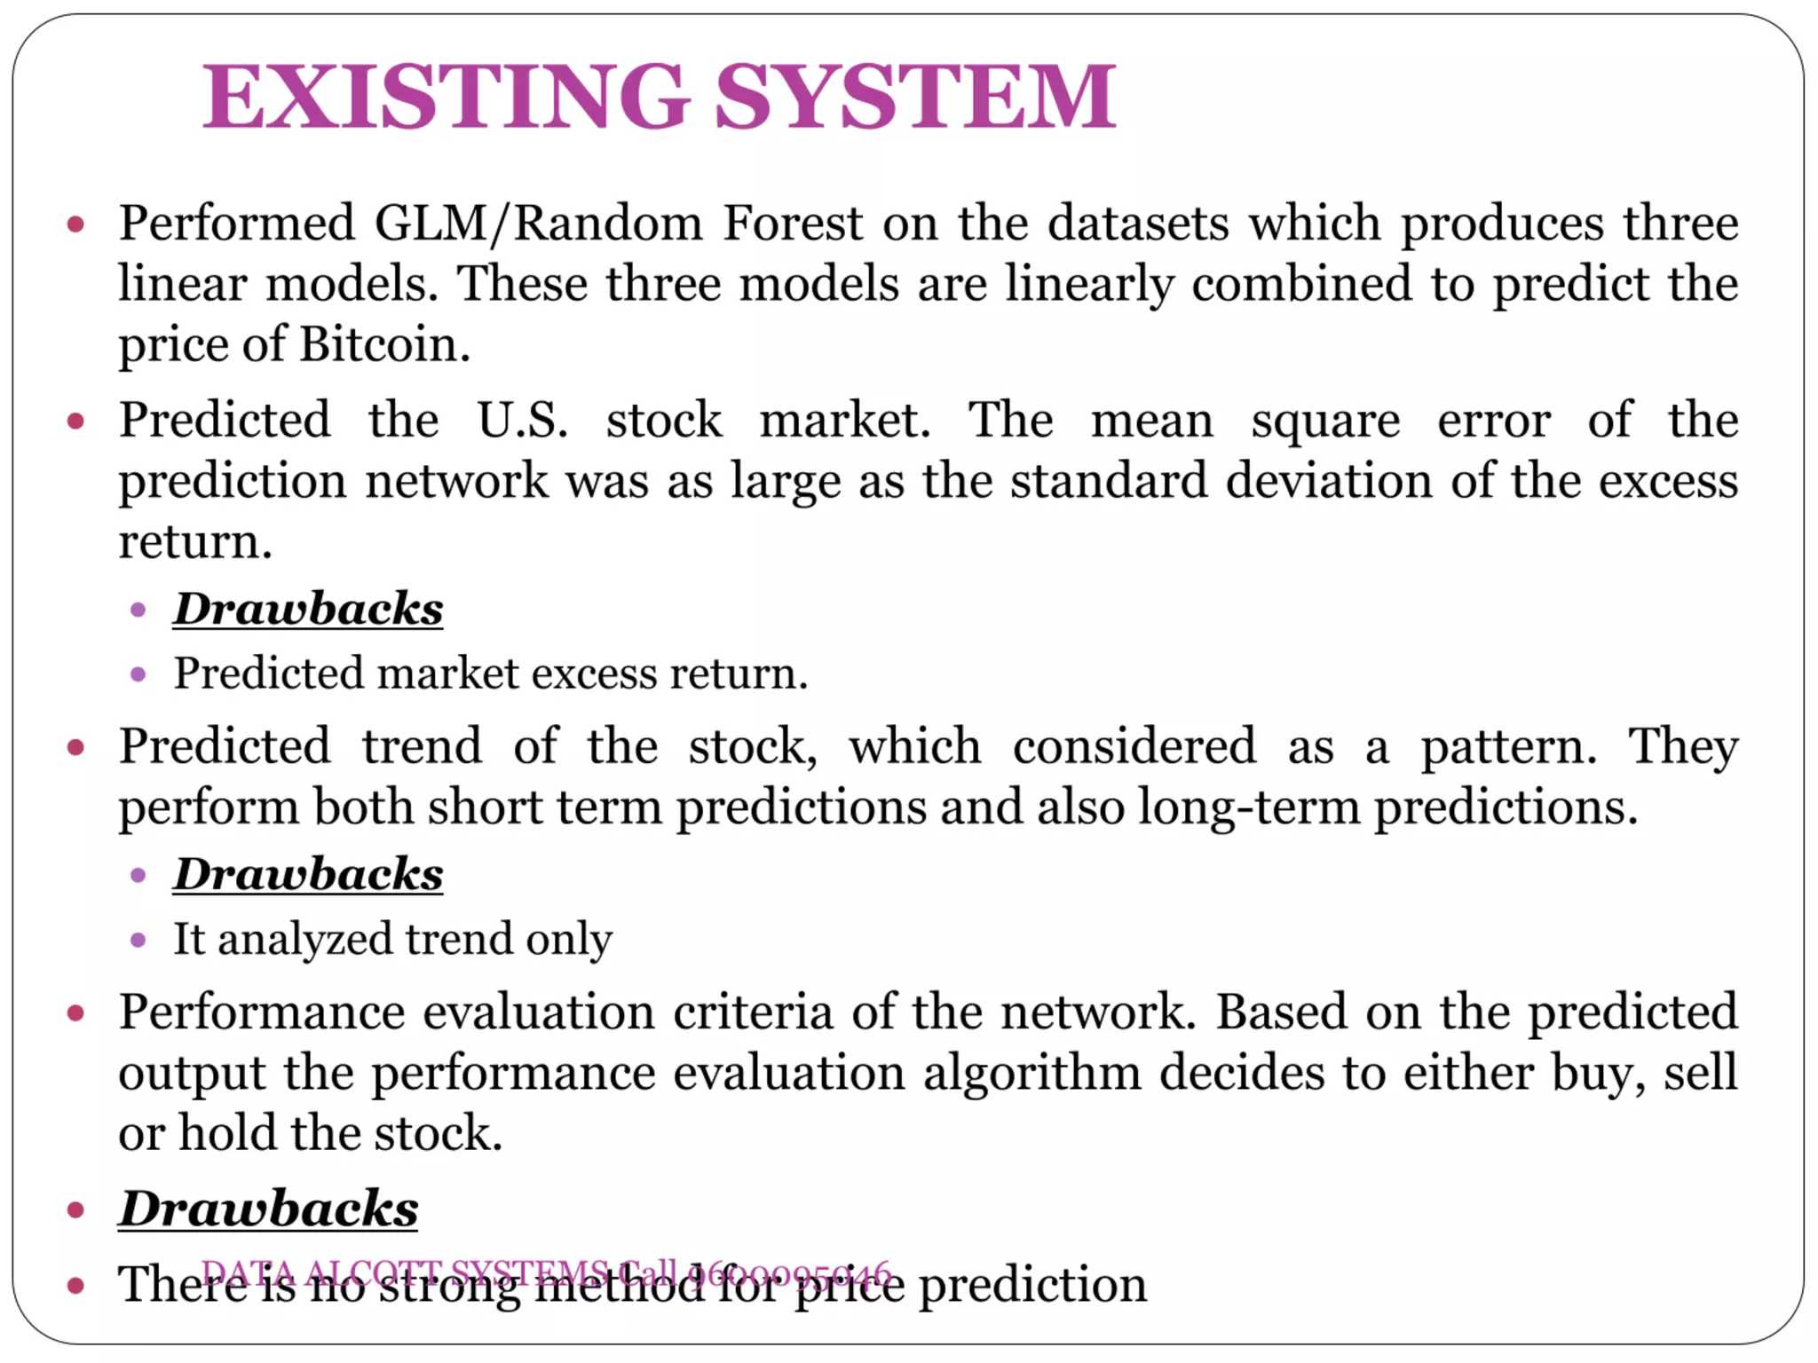
There is no strong method for price prediction

Slide 7
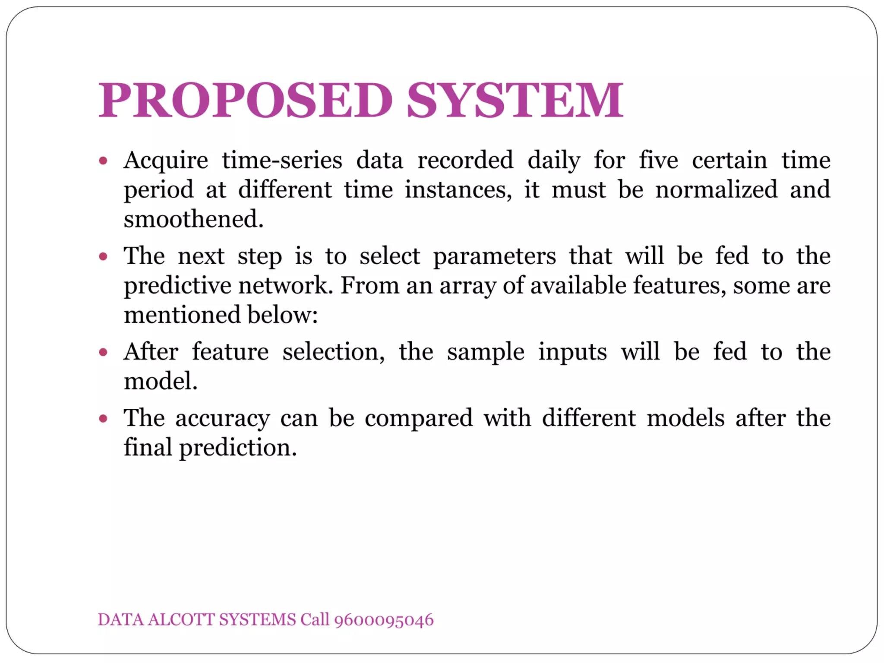

Slide 8
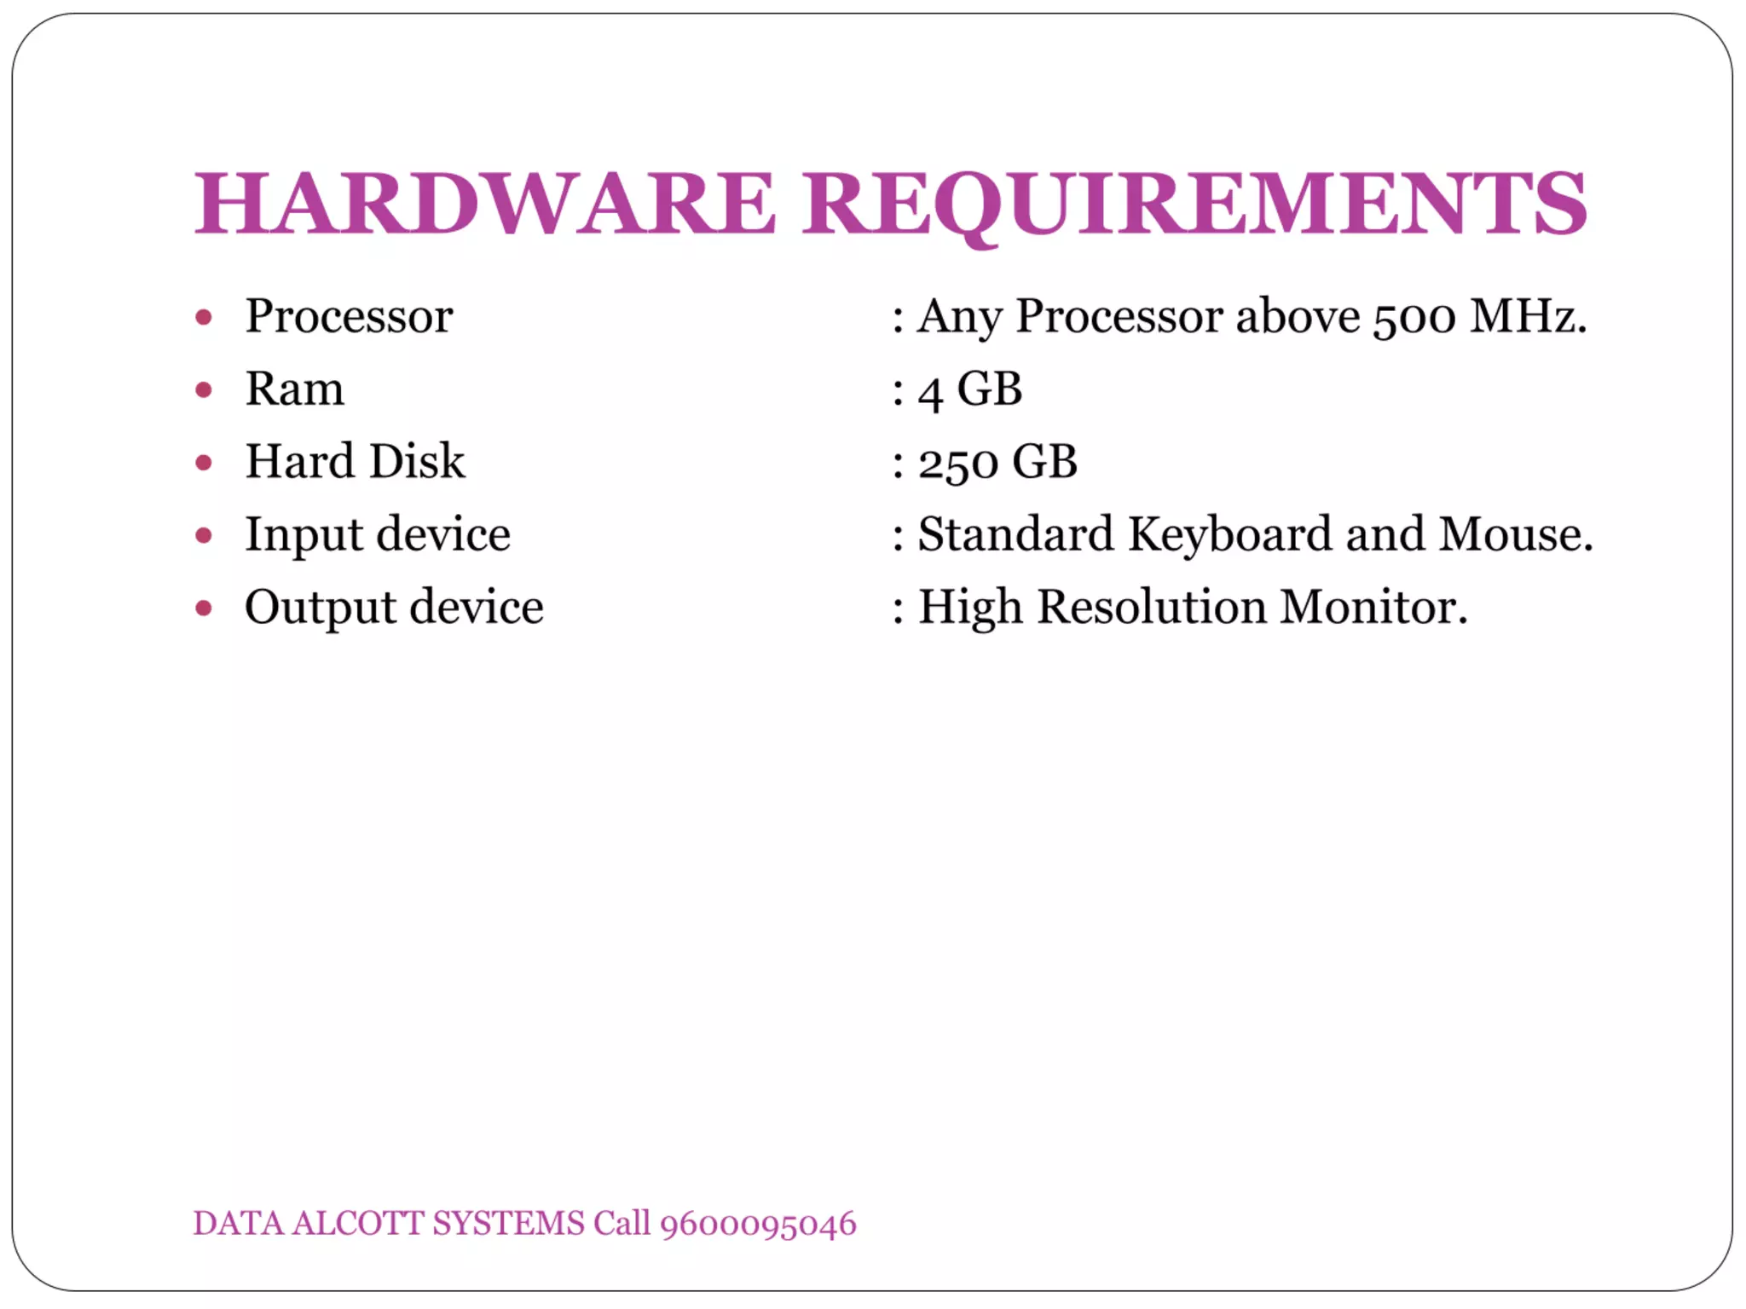

Slide 9
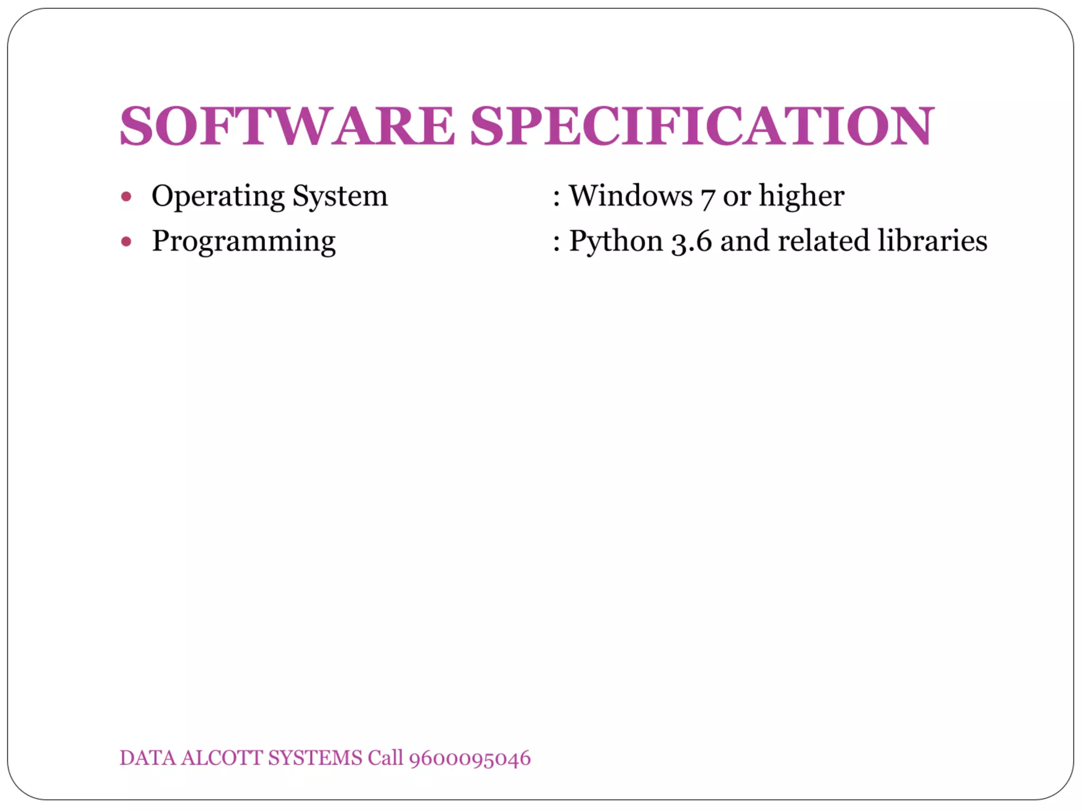

Slide 10
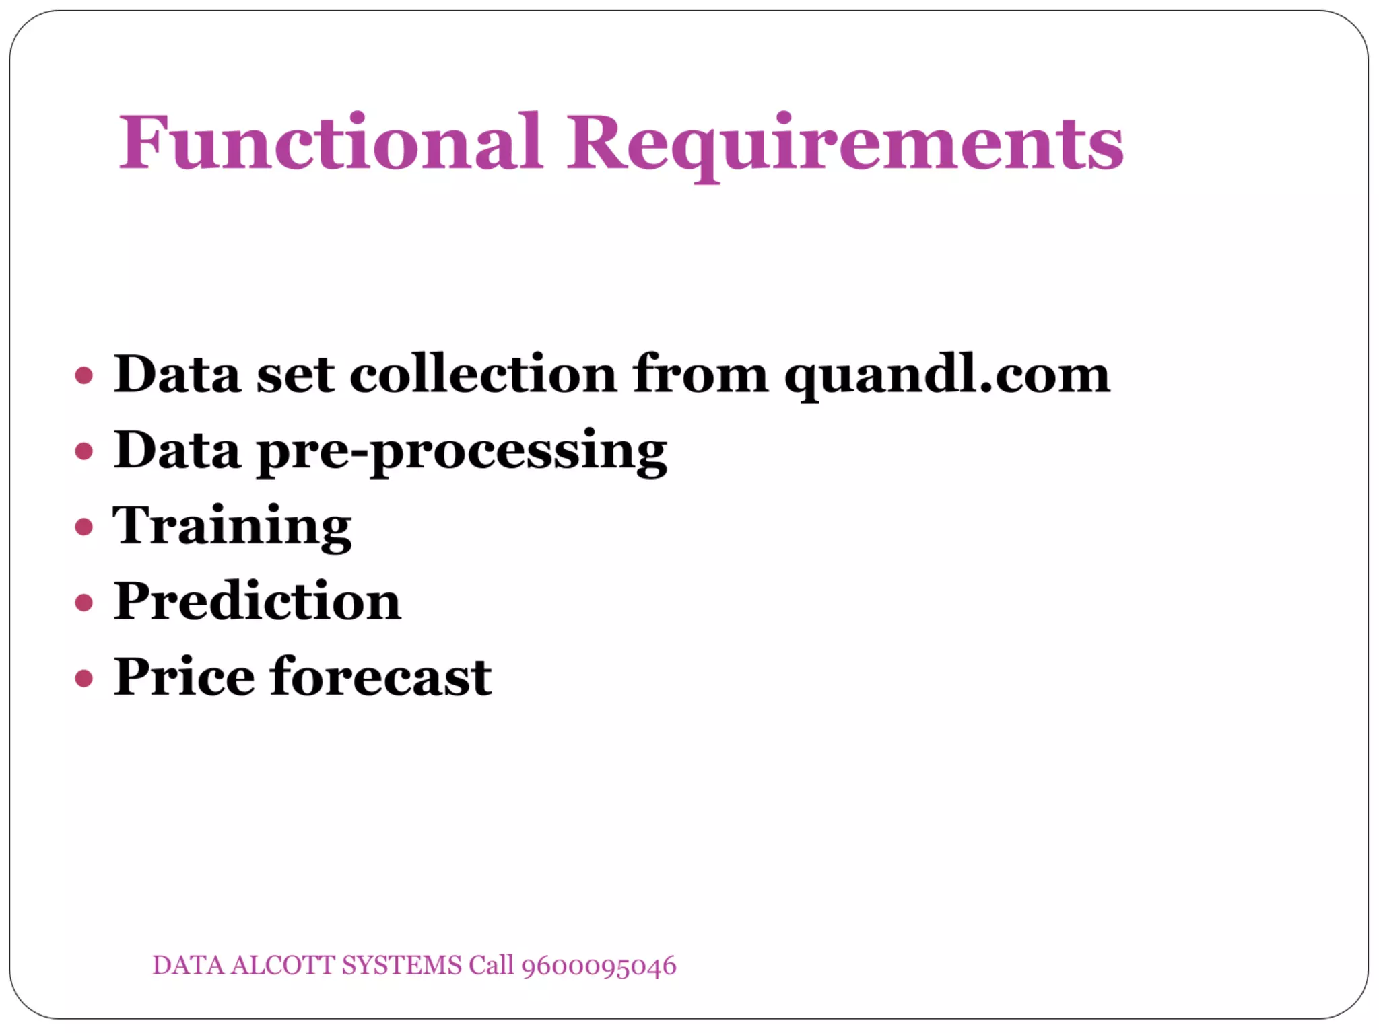

Slide 11
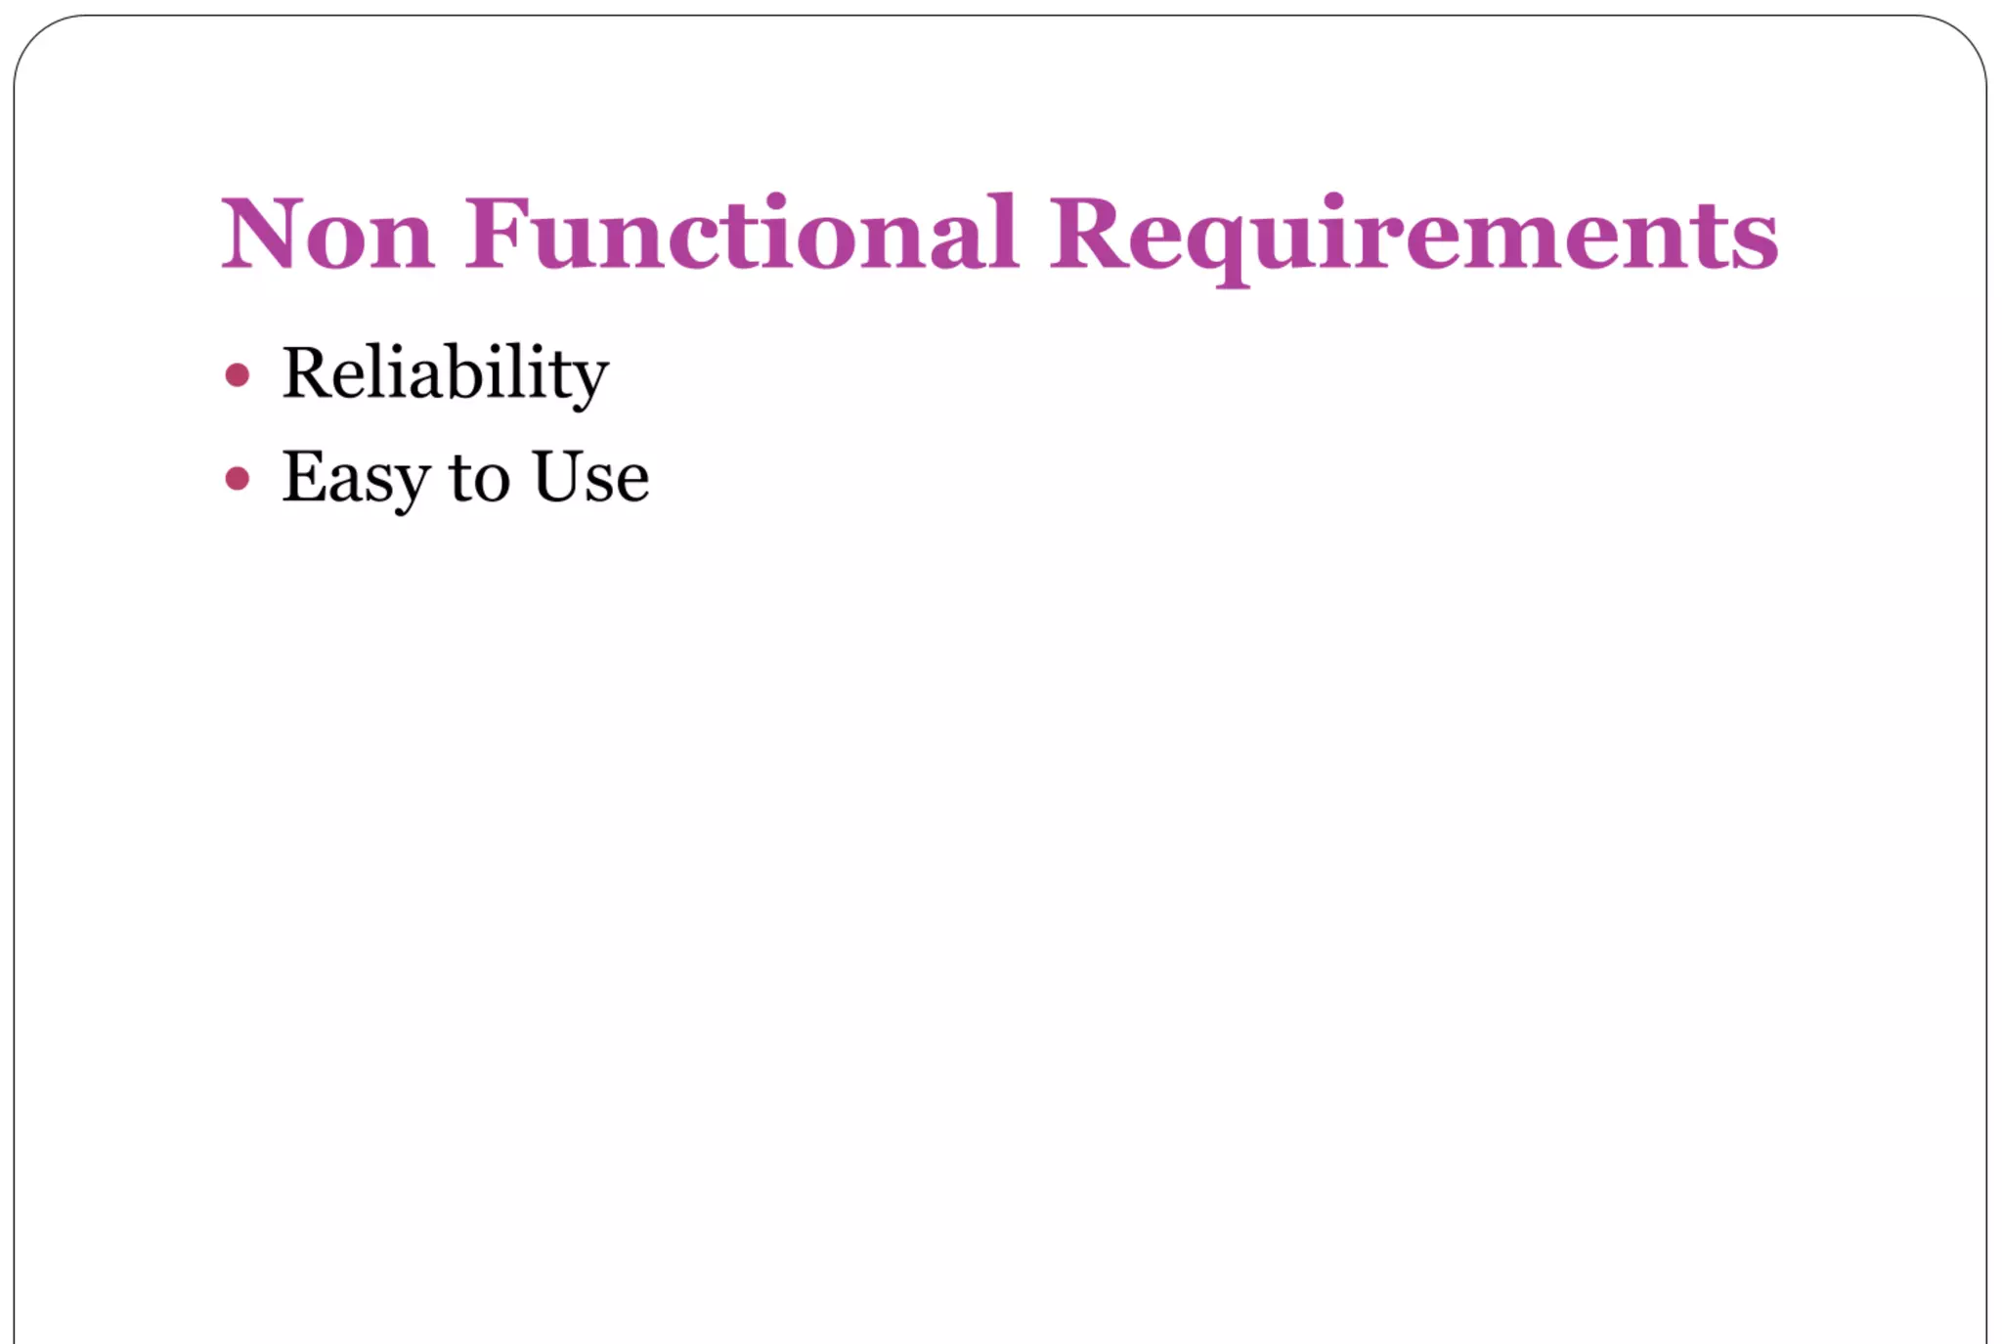

Slide 12
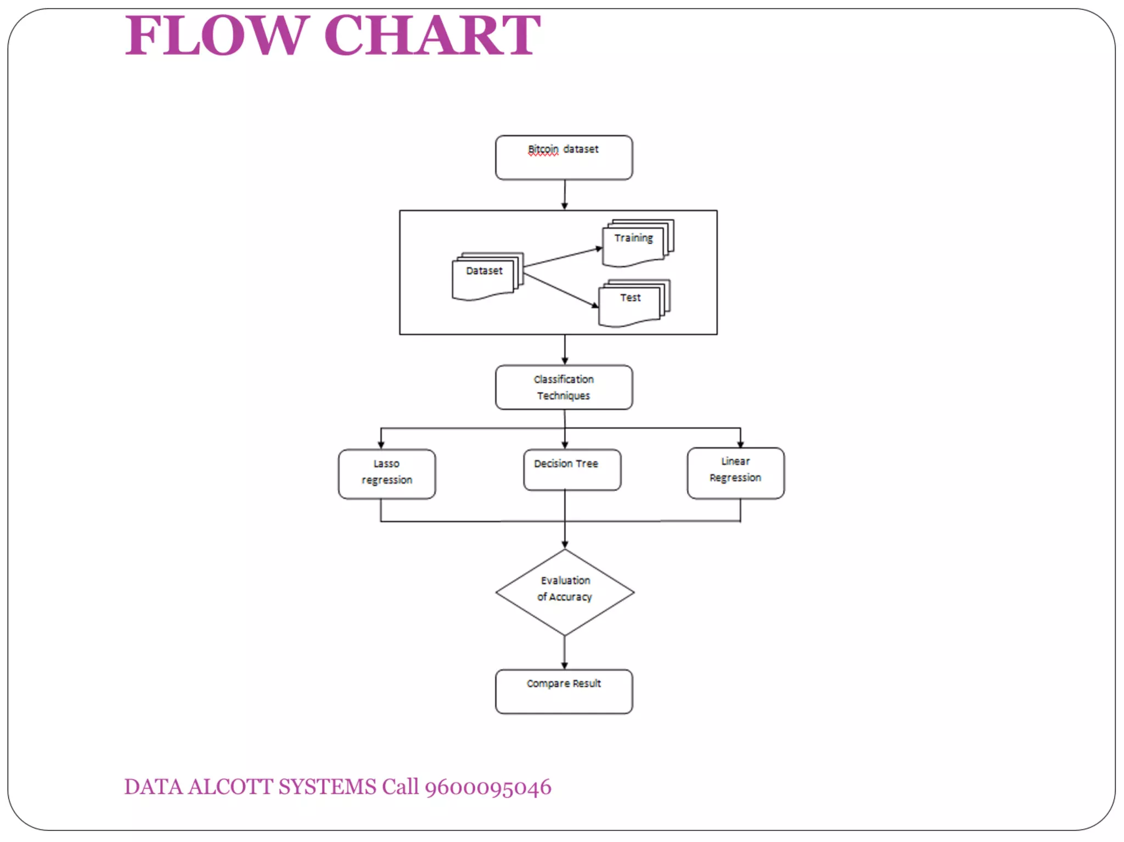

Slide 13
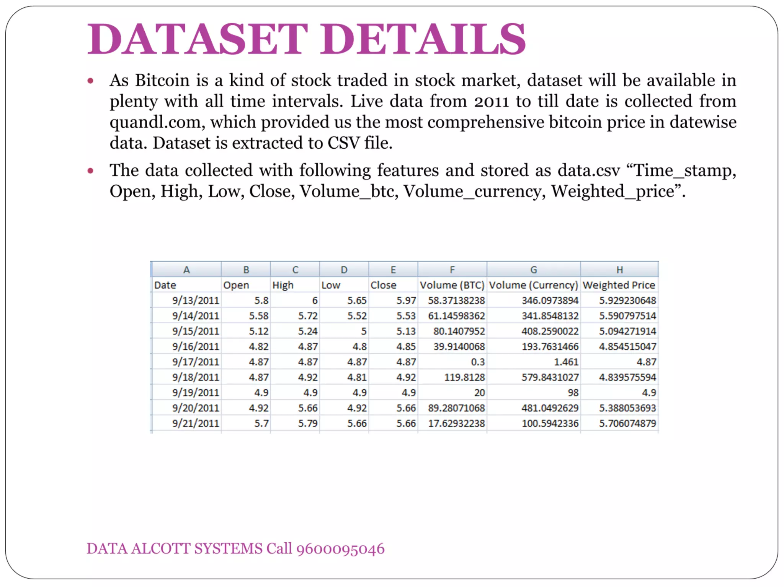

Slide 14
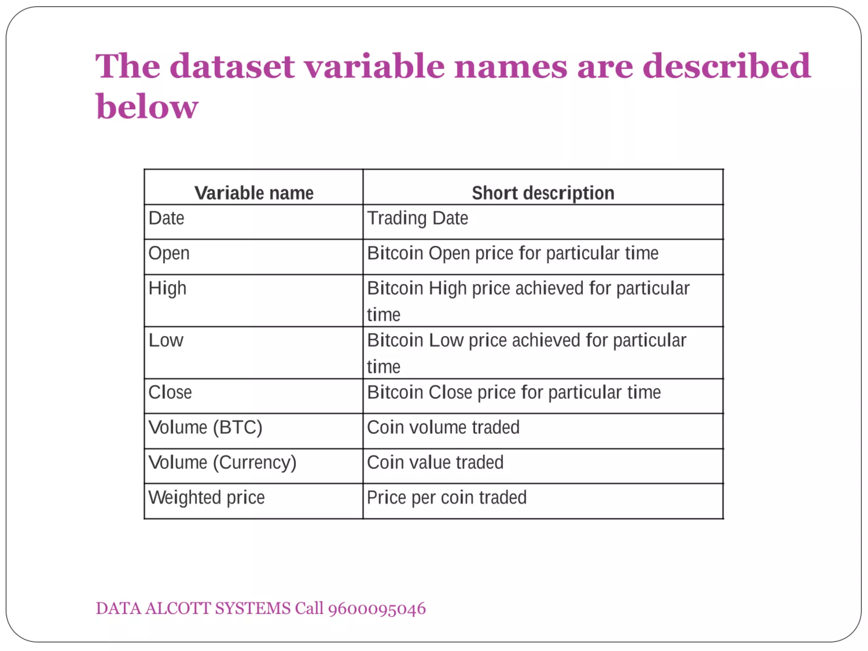

Slide 15
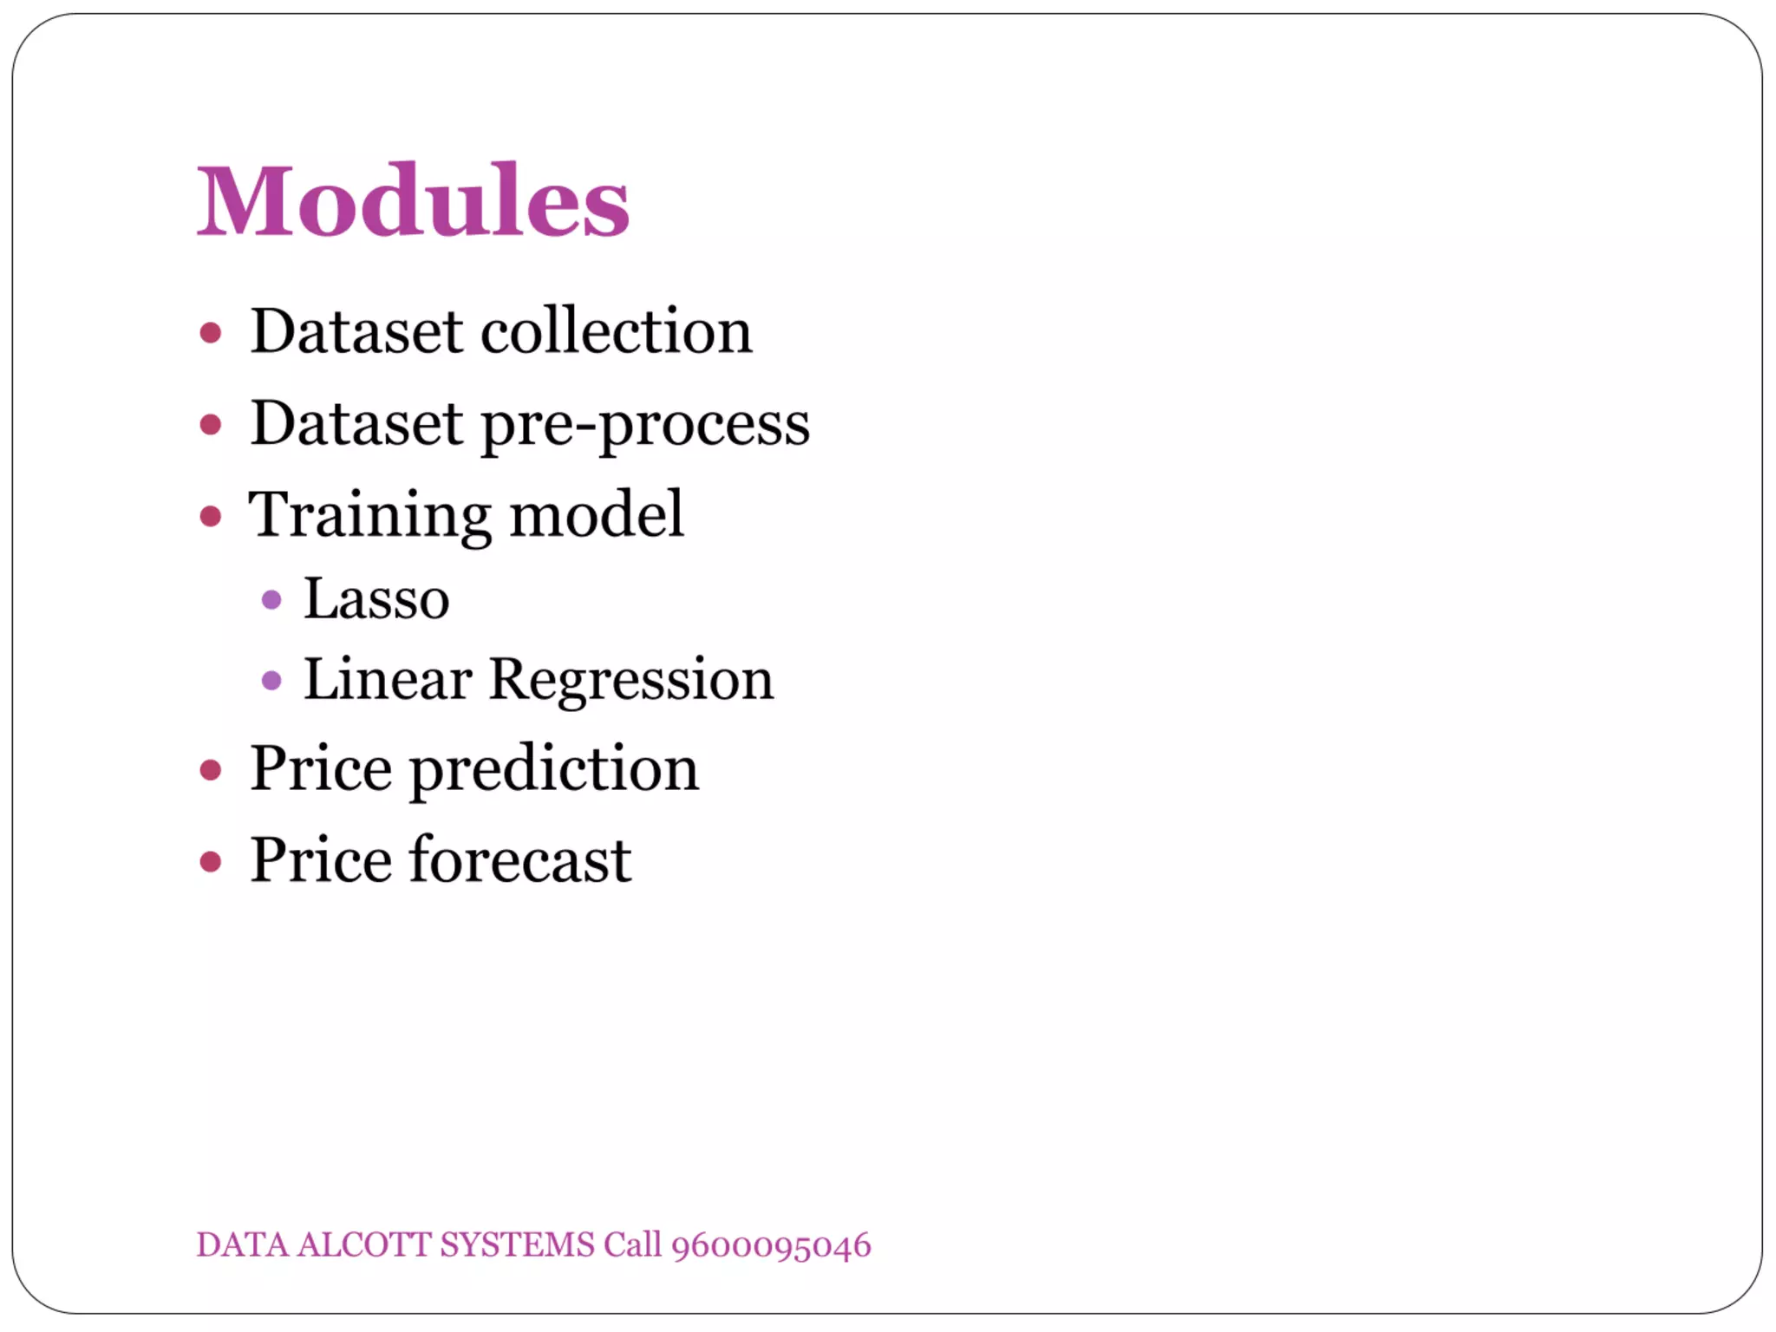

Slide 16
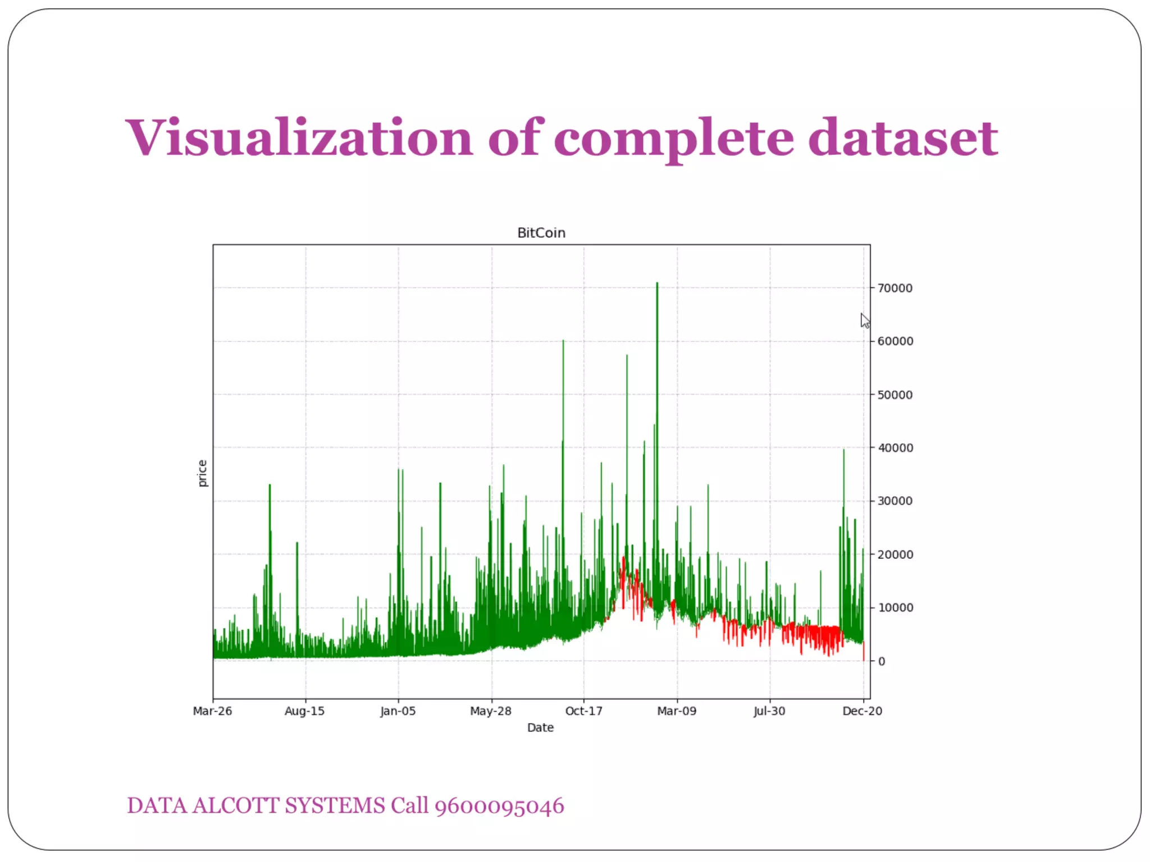

Slide 17
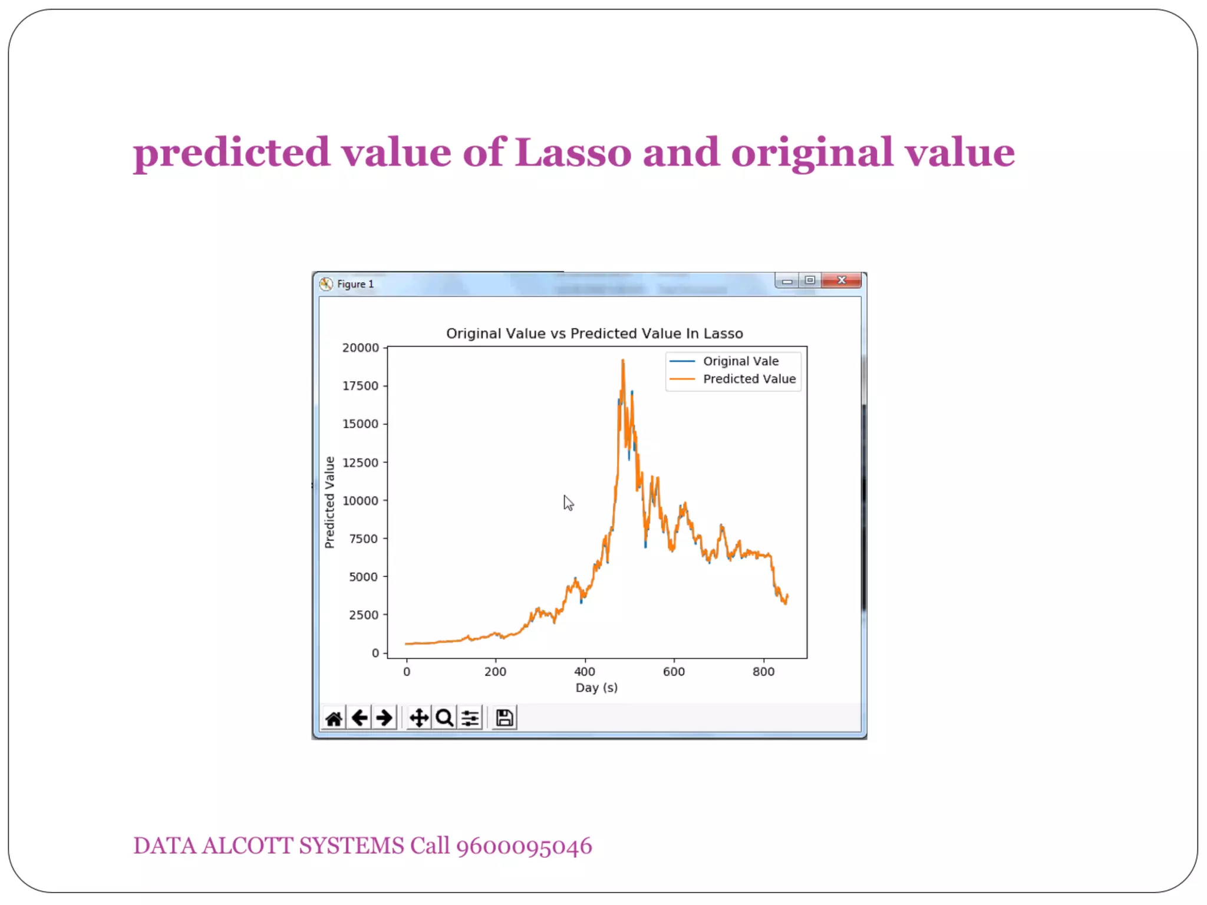

Slide 18
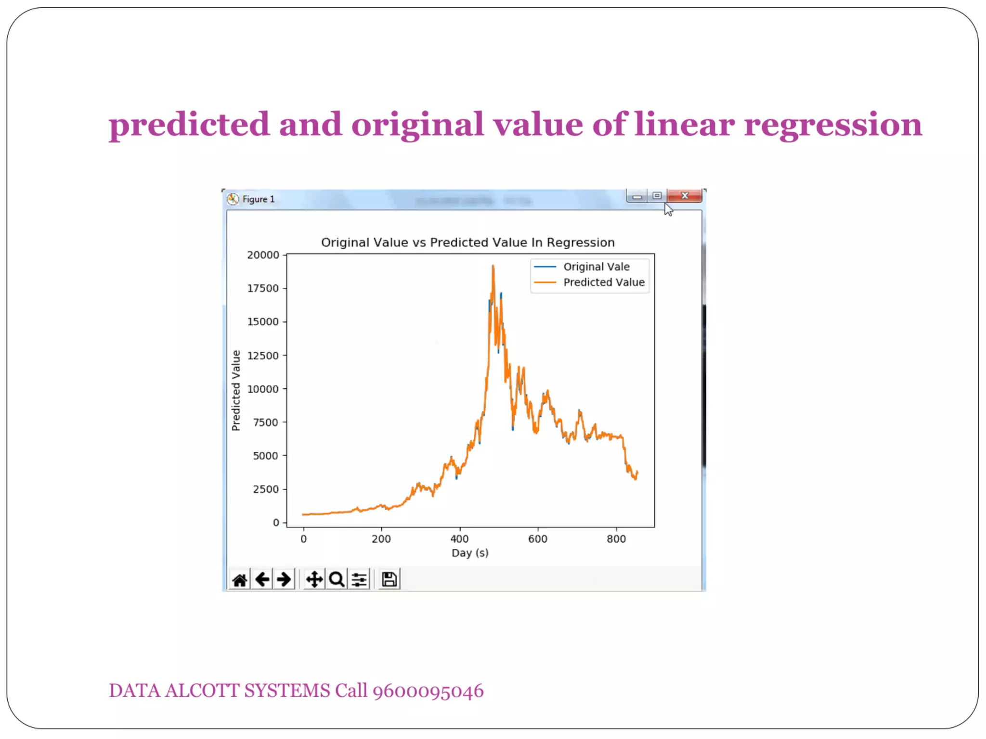

Slide 19
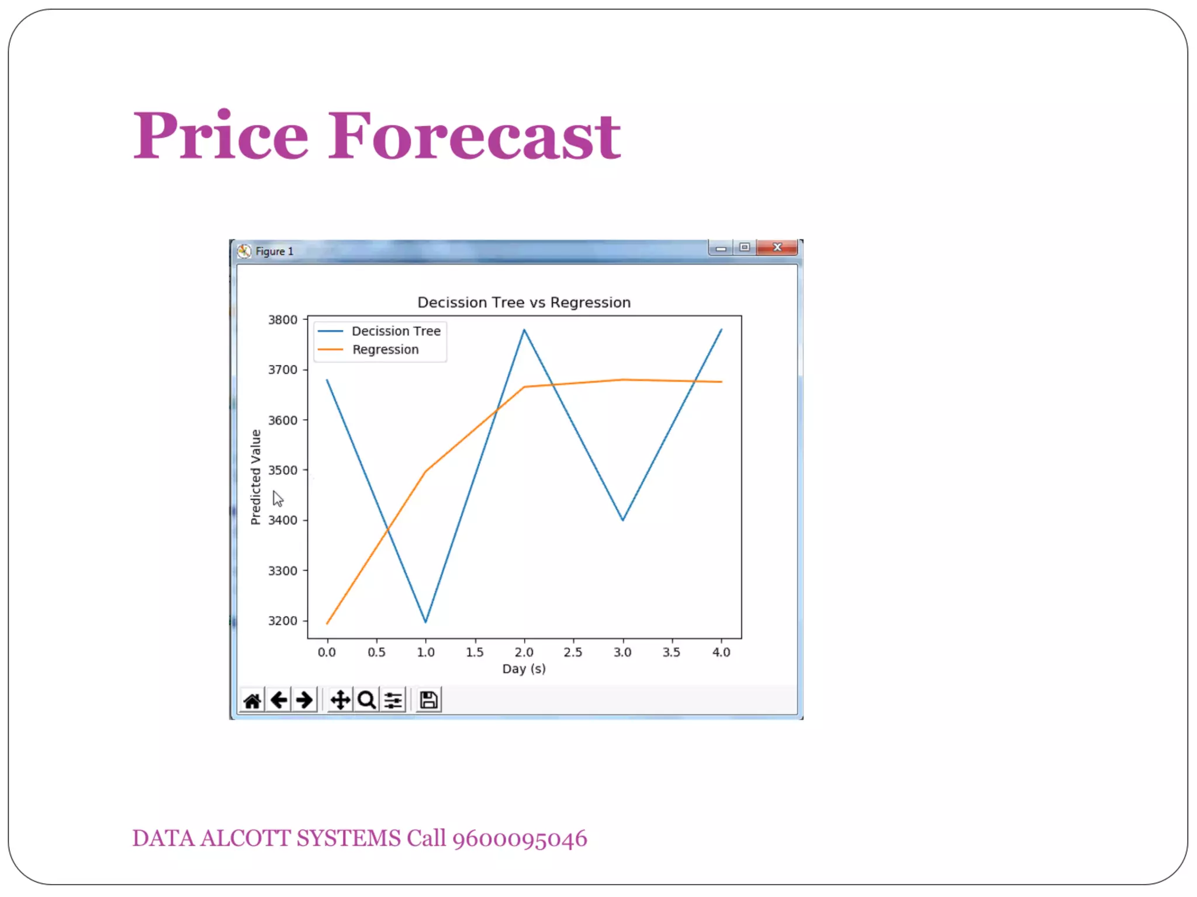

Slide 20
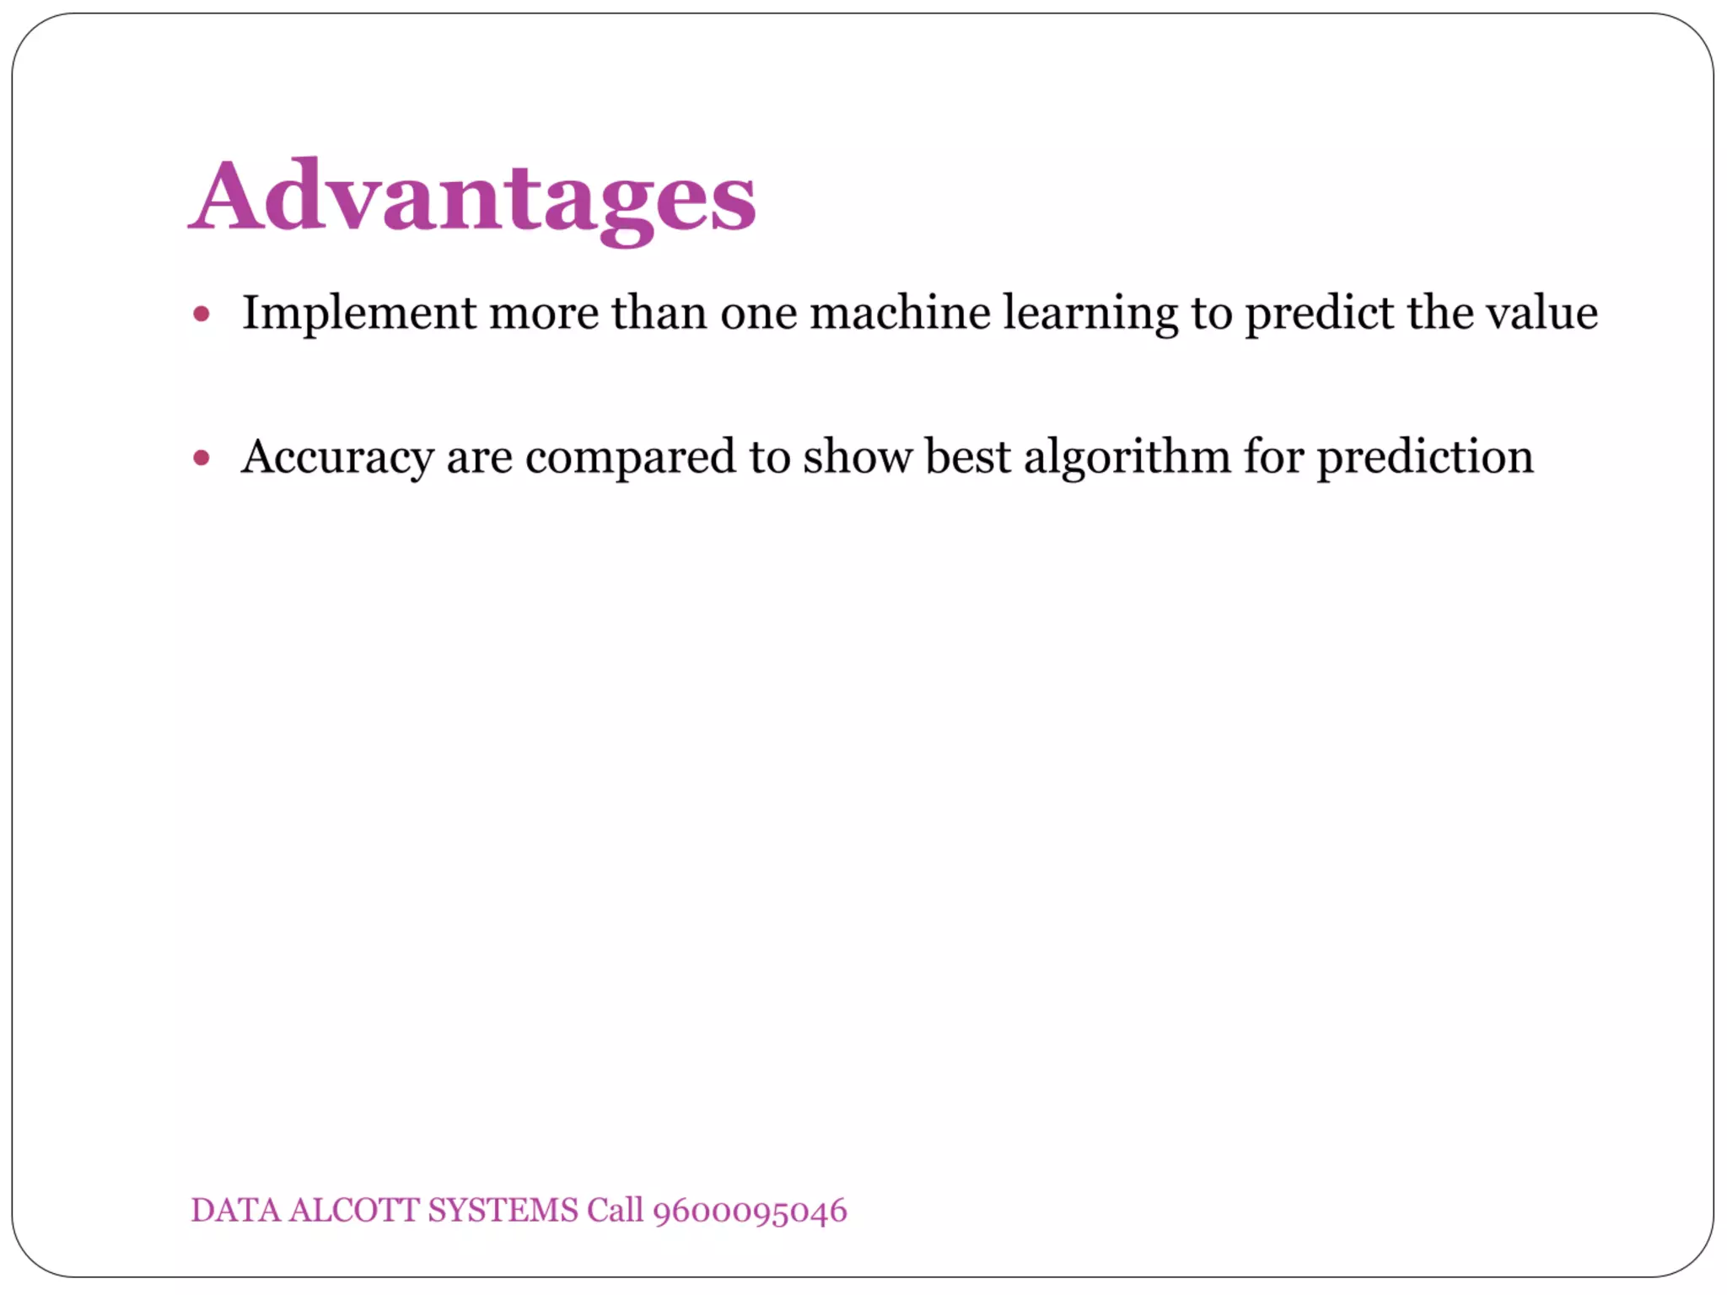

Slide 21
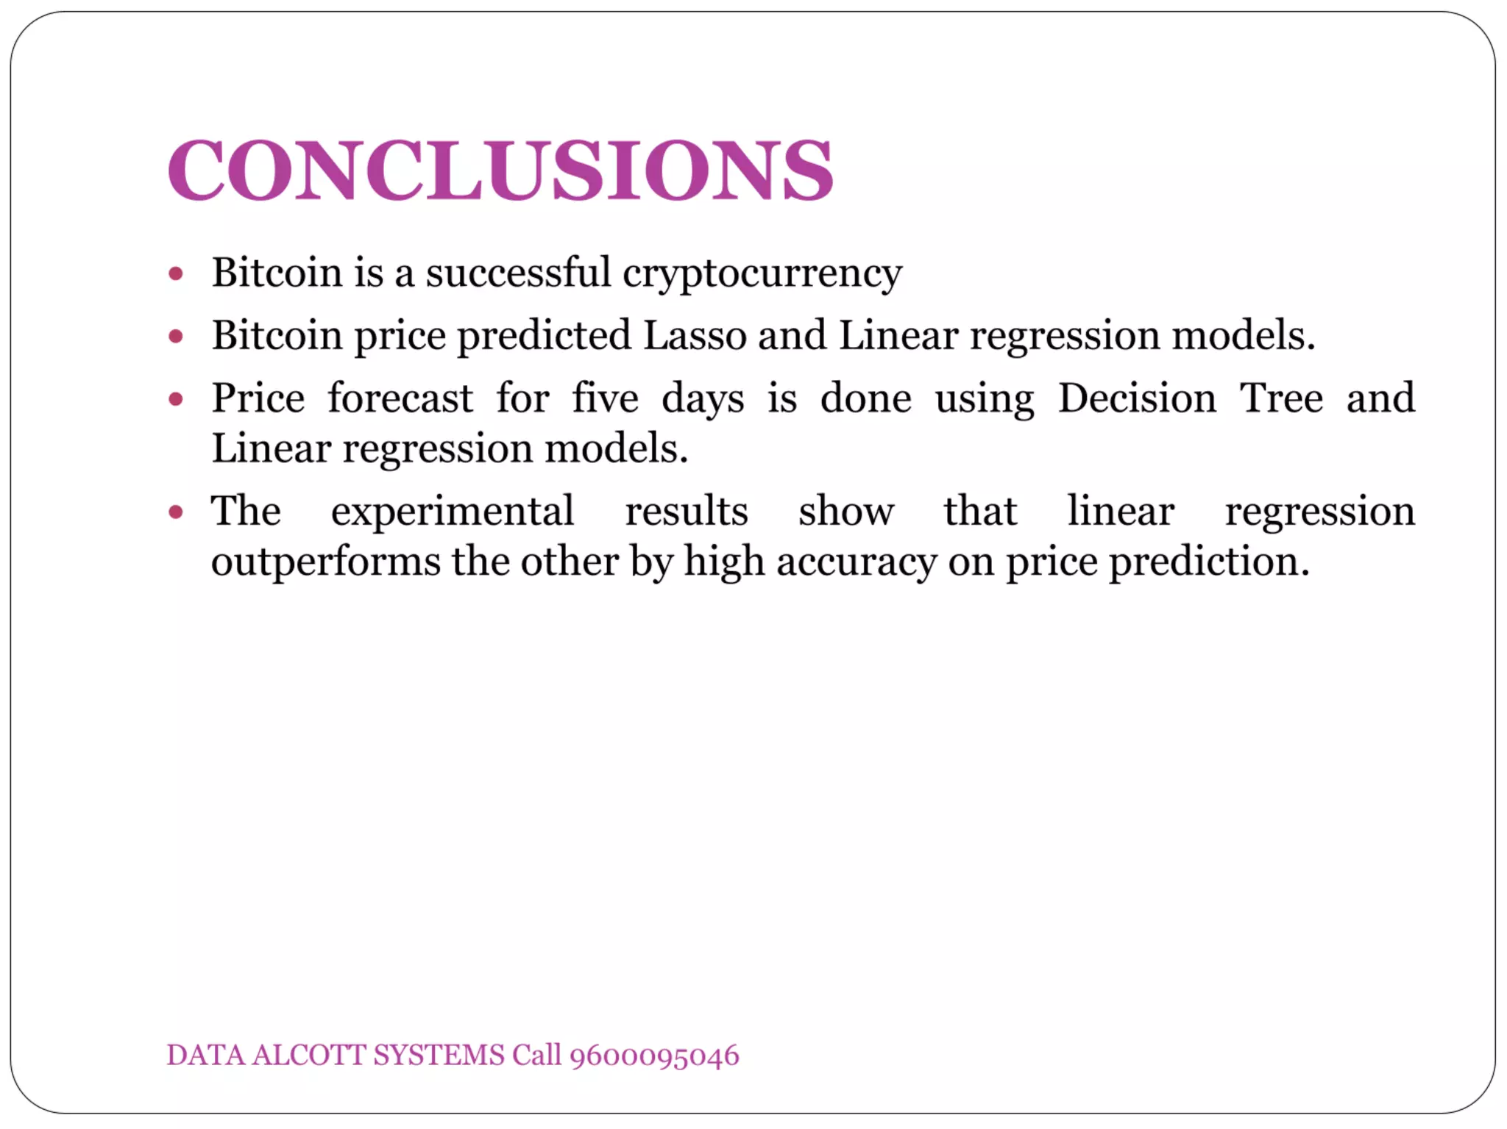

Slide 22
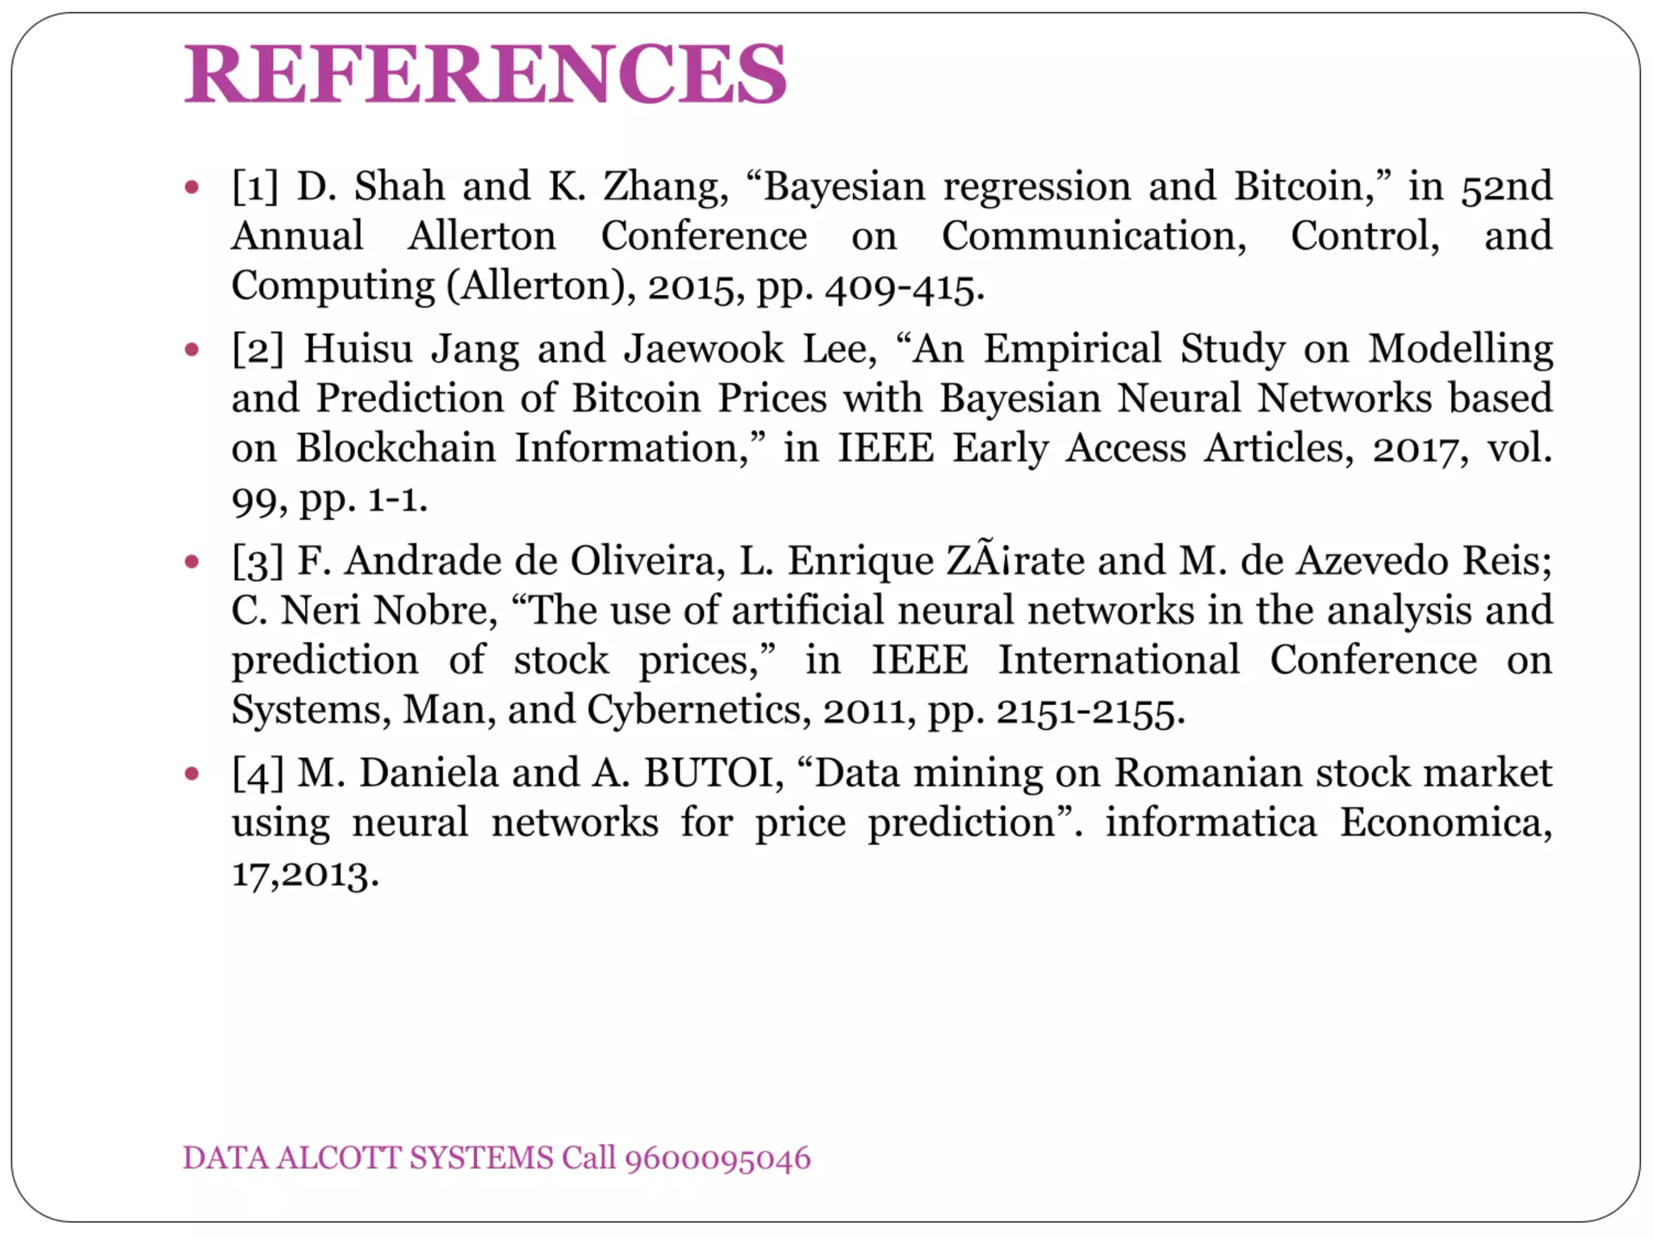
https://github.com/Kshitijkr31/bitcoin-price-prediction

